Slide 1

Sprint #4
IGVC
AutoMav
Dario Ugalde, Awet Tesfamariam, Andrew Break, Amgad Alamin, Warren Smith

Slide 2
Sprint Goal
Create Detailed Design Specification
Set up object recognition.
Get started on waypoint navigation
Rebuild ROS
Assemble Chassis

Slide 3
Sprint Backlog (Design)
Item | Time Estimate (hours) | Time Taken (hours)
Detailed Design Specification | 5 | 5
Set Up Object Recognition | 6 | 4
Waypoint Navigation | 6
Rebuild ROS | 7 | 8
Assemble Chassis | 9 | 2

Slide 4
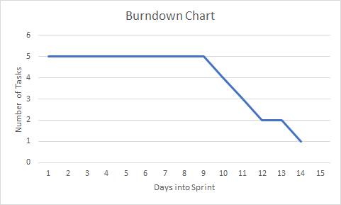
Burndown Chart

Slide 5
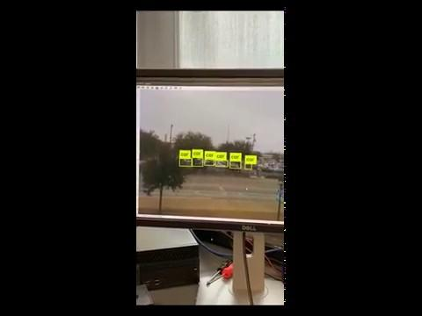
Object
Recognition

